Slide 1
FOCUS ACADEMY
KG TO 12
ENGLISH &GUJARATI MEDIUM
Almas Ahmad Shaikh
9099818013 8780997670

Slide 2
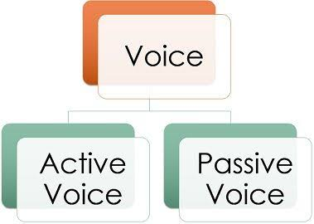

Slide 4
FOCUS ACADEMY

Slide 5
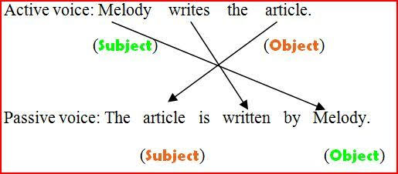

Slide 8
FOCUS ACADEMY

Slide 10
FOCUS ACADEMY

